Slide 1
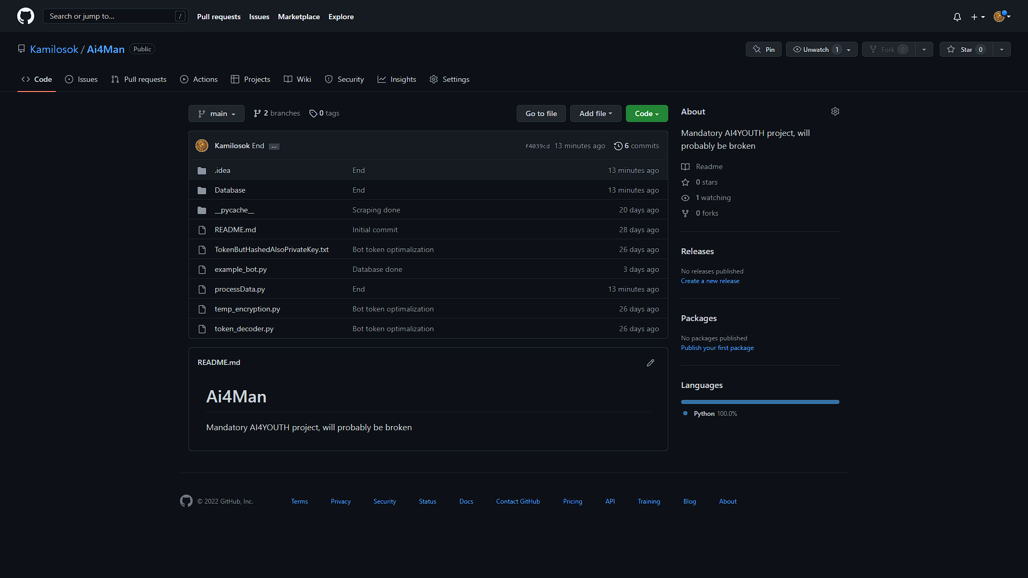
Ai4Man
Presentation prepared by Kamil Zdancewicz

Slide 2

What is Ai4Man?
Ai4Man was supposed be to be a tool to scrape data from discord text channels and rate the toxicity of each message, further down the road the features could be expanded to identifying the most toxic users or analyzing chains of messages.

Slide 3
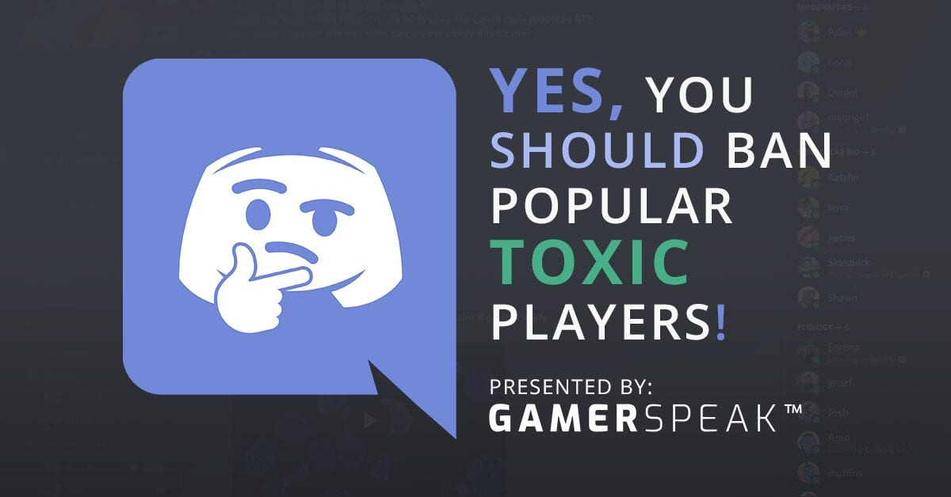
How does Ai4Man work?
First it uses discord.py API with a discord bot prepared beforehand to scrape data off of specified text channels and saves it into a database, then a different script learns to evaluate the toxicity of each message and then rates any future ones.

Slide 4
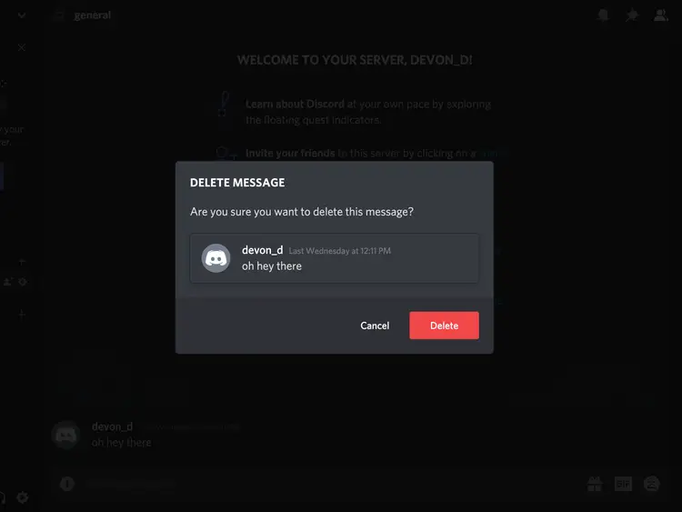
The possible future of Ai4Man
If more development will be done, the project could be turned into a discord bot that assesses and maybe controls toxic messages on the fly, what could be a great improvement to servers that strive to be family friendly.

Slide 5
Sources
https://github.com/Kamilosok/Ai4Man
https://www.google.com/url?sa=i&url=https%3A%2F%2Fwww.gamerspeak.io%2Fdont-hesitate-take-action-and-ban-toxic-players%2F&psig=AOvVaw1svUjzC6MOI4rnqMh25GhK&ust=1666007528704000&source=images&cd=vfe&ved=0CA0QjRxqFwoTCOCS8OjX5PoCFQAAAAAdAAAAABAE
https://www.google.com/url?sa=i&url=https%3A%2F%2Fwww.businessinsider.com%2Fguides%2Ftech%2Fhow-to-delete-discord-messages&psig=AOvVaw00wTJXq2di15VRRNEmPBZW&ust=1666007747749000&source=images&cd=vfe&ved=0CA0QjRxqFwoTCIDWo9HY5PoCFQAAAAAdAAAAABAI

